Slide 1

Predicting customer buying behavior

Slide 2
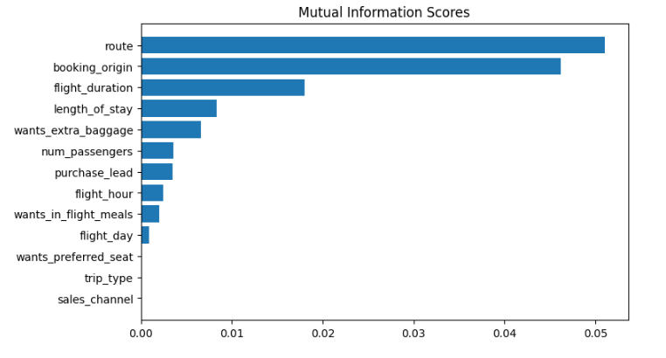
We have trained the data set with Random forest classifier model and received
ACCURACY: 85.09
AUC score: 0.558
route
Booking origin
flight duration
Wants extra baggage
Length of stay
are the top 5 features which influence
customer buying behavior
There is a need in increase of AUC score.

